Slide 1


tutti
On demand tutoring you can trust.

Slide 2





Meet the Team
Jennifer Lew (’26)
Computer Science (AI) Palos Verdes, CA
Alex Yansouni (’26)
Computer Science (HCI) Los Altos, CA
Meghana Paturu (’26)
Computer Science (HCI) &
Economics Belle Mead, NJ
Jonah Blaydes-Greenberg (’26)
Computer Science (HCI) & Music Los Altos, CA

Slide 3

Table of Contents
Recap
New solution
Market research
Design values
Tasks
Video

Slide 4

Recap: Our Vision
1
Student-Tutor Matching
Students can make requests to peer tutors who match their specific needs, allowing them to work around their own schedules and set their tutoring rates.
2
Ethical Considerations
Ensuring user safety, data privacy, equity and access, and academic integrity are top priorities.
3
Serving Students and Tutors
Tutti will provide students with quick and quality academic support, while also offering capable students the opportunity to earn money through tutoring.

Slide 5
Identifying the Gap
Feedback and Insights
Market Research
Refined Solution
Interviews with potential users revealed challenges such as difficulty keeping track of everything learned during longer tutoring sessions, uncertainty about how to move forward after a session, and the challenge of booking tutoring within a quick timeframe with a fitting tutor.
Our market research identified a gap in the current offerings, presenting an opportunity to leverage AI technology to enhance the peer-to-peer tutoring experience for college students.
Tutti aims to solve the inefficiency and inconsistency of accessing quality peer-to-peer tutoring by providing on-demand peer tutoring and AI-powered learning support for college students.

Slide 6

What our interviewees said
“SO much gets covered during a longer tutoring session it's hard to keep track of everything I’ve learned”
“Sometimes I’m not sure how to move forward after learning a bunch of things from a tutoring session”
“I think it's hard to book tutoring within a quick timeframe with a tutor that knows what I need to learn”

Slide 7

Our refined solution
1
On-demand peer tutoring and AI-powered learning support for college students.
2
Problem:
Solve the inefficiency and inconsistency of accessing quality peer-to-peer tutoring for college students
3
Serving College Students and Tutors
College students seeking on-demand academic support and a seamless tutoring experience.
Capable college students can earn money by offering their expertise as peer tutors on the Tutti platform.

Slide 8
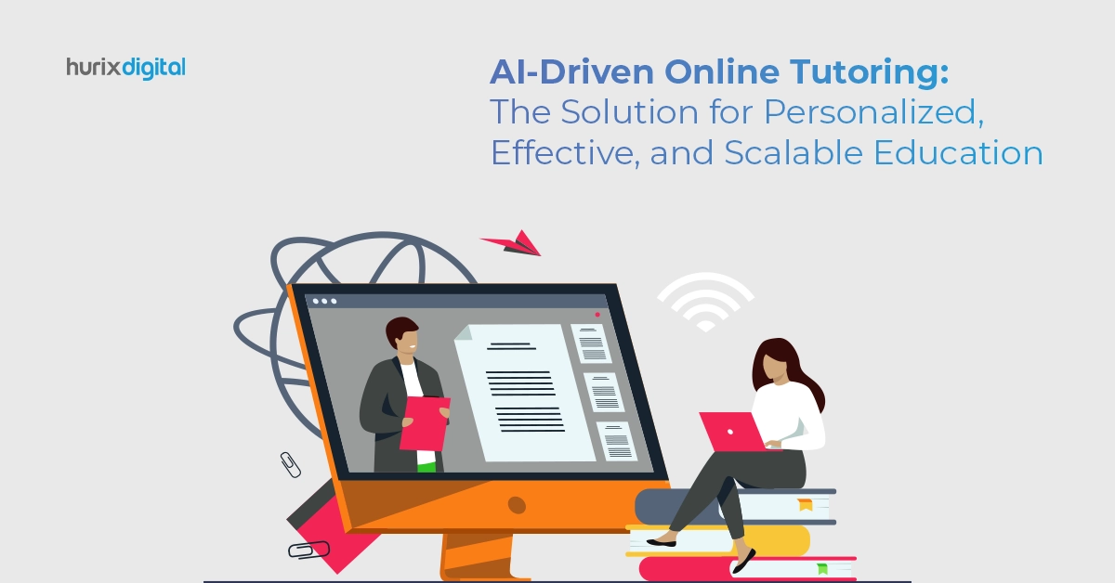
Tutti's Key Features
On-Demand Tutoring
Collaborative Learning
Students can send tutor requests to all available tutors that fit their criteria, and tutors can pick up requests based on their own schedule, creating a streamlined process to schedule a session quickly with a knowledgeable peer.
Tutti's platform fosters a seamless, collaborative learning environment where students and tutors come together to learn and grow, supported by the platform's features and technology.
1
2
3
AI-Powered Support
Tutti's integrated AI generates insightful notes, including summaries, action steps, and areas of improvement, to enhance the overall tutoring experience and help students stay organized and on track.

Slide 9

Why "Tutti"?
Meaning and Symbolism
Tutti, the Italian word for "together," symbolizes the collaborative and unifying nature of the platform, where students and tutors come together to learn and grow.
Phonetic Connection
The name "Tutti" is phonetically identical to "tutee," creating a clever play on words that directly relates to the platform's focus on tutoring and academic support.
Reflecting the Mission
The name Tutti reflects the platform's mission of creating a seamless, collaborative learning environment for college students, fostering a sense of unity and shared success.

Slide 10




Tutti's Impact
Improved Academic Performance
Tutti's on-demand tutoring and AI-powered learning support will help students achieve better academic outcomes and reach their full potential.
Enhanced Learning Experience
The platform's seamless, collaborative approach will create a more engaging and rewarding learning experience for students.
Increased Earning Potential
Capable students can leverage Tutti to earn money as peer tutors, providing them with valuable work experience and additional income.

Slide 11

Market Research

Slide 12

Wyzant
“Expert Tutors at Affordable Prices”
What Works
What Doesn't Work
Not college-specific, leading to a diluted experience where students must navigate a broader audience, including K-12 and adult learners
Wyzant offers a wide range of subjects, allowing college students to find help in almost any area of study
Time consuming manual tutor search process
Lack of AI-powered tools like automatic note-taking or session summaries leaves students without valuable support

Slide 13

Nightowl
“Get help now”
1
What Works
Nightowl allows college students to quickly find peers to collaborate with on academic projects.
2
What Doesn't Work
Does not provide a way for students to receive academic help from qualified individuals

Slide 14

Superprof
“Find the perfect tutor”
What Works
What Doesn't Work
Superprof's global reach offers access to tutors in a variety of specialized subjects, potentially covering niche or advanced college-level topics from around the world.
Lacks a community of learners or tutors that specialize in college-specific needs.
Inefficient manual tutor search process
Requires users to message tutors and wait for responses (similar to Wyzant)

Slide 15


Stanford Tutoring: Convenient but Scattered
What Works
What Doesn't Work
Stanford's tutoring organizations offer convenient access to tutoring services provided by fellow students.
Scattered across academic subjects
Difficult for students to find the right help in a timely manner
TAs may not always be experienced in the specific course content, limiting the effectiveness of the tutoring sessions

Slide 16
Identifying Key Opportunities
College-Focused Platform
Efficient Matching
AI-Powered Assistance
Implementing a dynamic matching system that quickly connects college students with the most suitable tutors, reducing the time and effort required to find the right support.
Integrating AI-powered tools, such as automatic note-taking, session summaries, and personalized study paths, to provide college students with valuable support and help them stay organized and on track.
Developing a tutoring solution tailored specifically to the needs of college students, with features and tools designed to enhance their academic experience.

Slide 17
Leveraging Strengths, Addressing Weaknesses
1
College-Focused
Develop a platform that caters specifically to the unique needs and challenges faced by college students, providing a tailored experience.
2
Efficient Matching
Implement a dynamic matching system that quickly connects students with the most suitable tutors, saving time and effort.
3
AI-Powered Support
Integrate AI-powered tools to assist college students with note-taking, session summaries, and personalized study paths, enhancing their academic journey.

Slide 18



Delivering a Transformative Tutoring Experience
College-Focused
Efficient Matching
AI-Powered Support
Tailored to the unique needs and challenges of college students.
Dynamic system that quickly connects students with the right tutors.
Integrates AI tools to enhance the academic experience.

Slide 19

Ethical Considerations
Direct Stakeholders
Indirect Stakeholders
Ethical Implications
Students who want to tutor
TAs who are overwhelmed by demand at office hours
Privacy
2. Data Security
Students who need tutoring but aren't adequately served by office hours
3. Over Reliance on AI
Teachers constantly receiving requests for personal help from students.

Slide 20

The Backstabber
1
Privacy and Safety
Ensure robust data protection protocols, clear consent processes, and transparent data-sharing practices to address concerns about personal information and the use of recorded tutoring sessions.
2
AI in the Background
The integration of AI to record and summarize tutoring sessions raises additional privacy concerns, requiring Tutti to prioritize security measures and user transparency.
3
Balancing Efficiency and Privacy
Tutti must find the right balance between the convenience of its Uber-like matching system and AI tools, and the need to protect user privacy and maintain trust in the platform.

Slide 21

The Siren
Over-reliance on Tutors and AI
Tutti must be cautious not to promote academic overdependence, where students become overly reliant on the constant availability of tutors and AI-generated content, rather than developing self-reliance and critical thinking skills.
AI and Academic Integrity
The presence of AI in every tutoring session, providing summaries and suggestions, raises concerns about the potential for students to over-rely on AI-generated content, potentially undermining academic integrity and authentic learning.
Balancing Accessibility and Autonomy
Tutti must find a way to make tutoring and AI tools easily accessible while still encouraging students to develop independent learning strategies and critical thinking skills.

Slide 22



Designing for Diverse User Needs
Simple Task: Opening the App
The app should open directly to a clear, intuitive home screen where users can easily view their options, such as sending a request or reviewing session details.
Moderate Task: Sending a Tutoring Request
The process of sending a tutoring request should be streamlined and intuitive, allowing users to choose the subject, select a tutor, provide a brief description, and specify the timing.
Complex Task: Setting Up Recurring Appointments
Setting up recurring appointments should be efficient, involving features like syncing calendars, setting regular availability, and confirming tutor schedules.

Slide 23

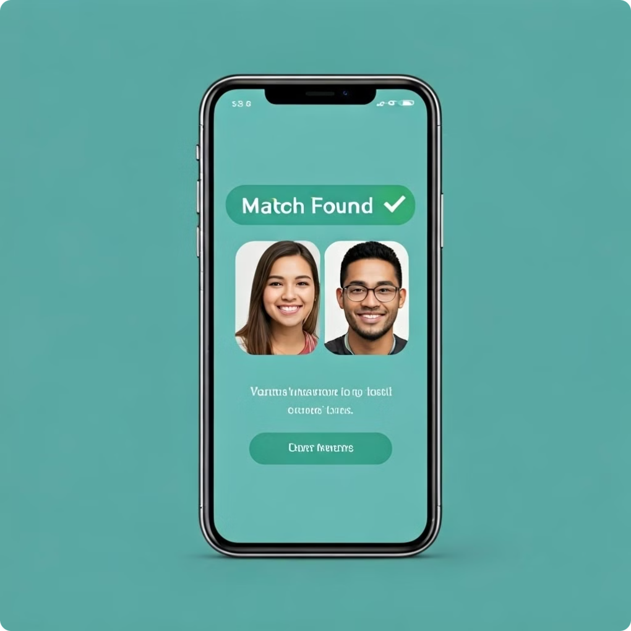
Empowering Students Through Personalized Support
1
Customized Matching
Tutti's algorithm matches students with the most suitable tutors based on their academic needs, learning styles, and schedules, ensuring a personalized tutoring experience.
2
AI-Powered Summaries
The platform's AI capabilities record and summarize tutoring sessions, providing students with valuable insights and allowing them to review key concepts and discussions.
3
Ongoing Support
Tutti's network of dedicated tutors and AI-driven tools work together to provide students with continuous academic support, fostering their growth and success.

Slide 24
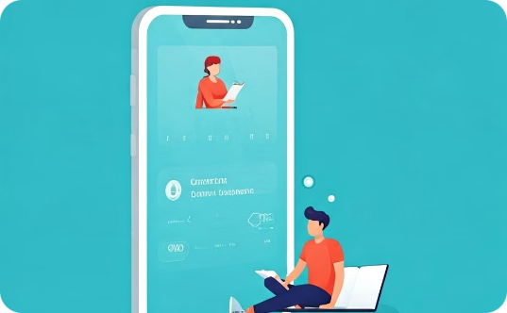
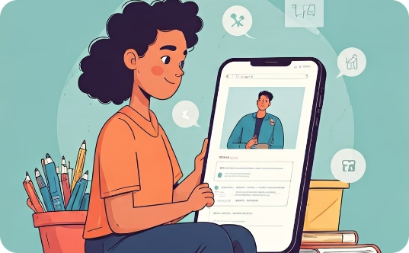

Revolutionizing the Tutoring Experience
Convenient Matching
Intelligent Insights
Collaborative Learning
Tutti's Uber-like matching system connects students with the most suitable tutors in real-time, ensuring they receive the help they need when they need it.
The platform's AI-powered features record and summarize tutoring sessions, providing students with valuable feedback and allowing them to revisit key concepts and discussions.
Tutti fosters a community of learners, connecting students with a network of dedicated tutors who are passionate about sharing their knowledge and supporting academic success.

Slide 25




Empowering Educators and TAs
Reduced Workload
Improved Insights
Enhanced Collaboration
Tutti helps alleviate the burden on TAs and professors by providing students with accessible, on-demand tutoring support, reducing the number of requests for personal assistance.
The platform's AI-generated session summaries and analytics give educators valuable insights into student learning, allowing them to identify areas for improvement and tailor their teaching strategies accordingly.
Tutti fosters a collaborative environment, where educators, TAs, and tutors can work together to support student success, share best practices, and continuously enhance the learning experience.

Slide 26
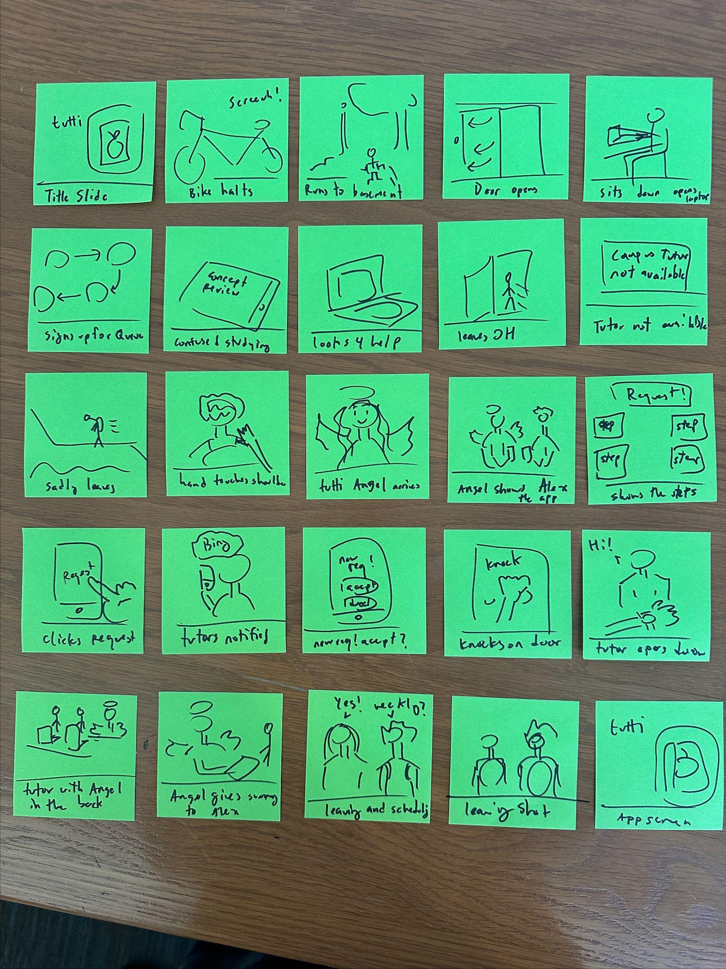
Storyboard

Slide 27
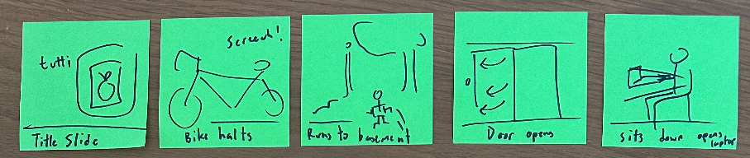
[Setting the Scene] –Learning about Alex’s Situation
Alex comes to Halting Stop on bike
He runs down the stairs to the Basement
Swings open the Opens Door to OH
Bursts in and Angrily Opens Laptop
Title Screen
[Mood Change] – Frantic to Frustrated

Slide 28
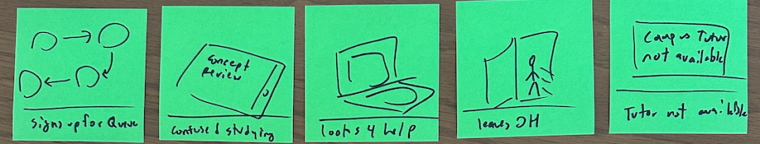
[Understanding Student’s Situation]
Alex’s Search for Tutoring
Opens the Long Queue and tries to join, seeing 3 hr wait
Struggle Studying for the exam
Begins his search for help online
Gives up and leave the OH, searching for help
Runs over and sees Sees the no help sign
[Mood Change] – Frustrated to Rejected
[Identify the Problem]
Long Queue and no help available

Slide 29
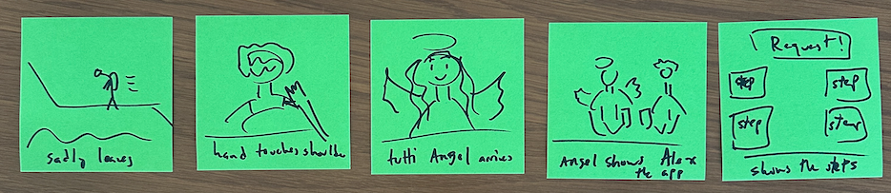
[The Angel Arrives!]
The Solution to Alex’s problems!
Task 1: Sign up for the app and fill out a profile
Sadly walks up the stairs of Huang Basement
Feels a Tap on his shoulder
The Angel Arrives and introduces her self as tutti
Introduces the tutti app and its features
Demonstrates how to set up a profile
Lowest Feeling
[Mood Change] – Rejected to Excited!

Slide 30
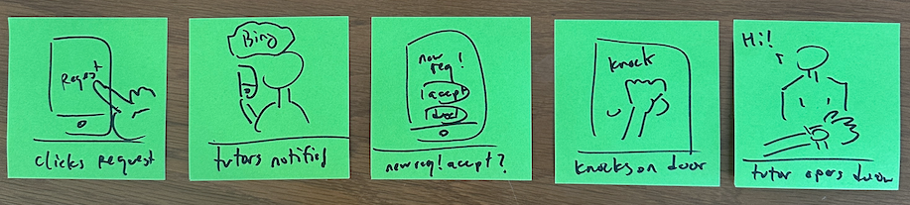
[Alex finds his support] Finally meets his tutor
Clicks Requests Help on the app to search for tutors
Many shots of tutors being notified with ping sound
Tutor checks calendar and Accepts
Alex goes to the tutoring room and knocks on the door
Tutor gives a short introduction
Task 2: Request a tutoring session and tutors are notified!
[Solution] –Tutoring begins!

Slide 31
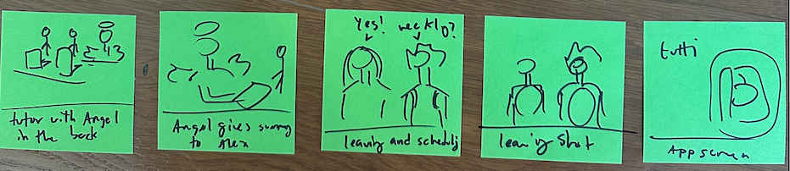
[Resolution] After the Session Finishes
Tutoring Session begins and the tutti angel sits behind taking notes
The Angel Presents Ai Notes
Alex Proposes Weekly tutoring
Tutor agrees and they Walk off
App Logo
[Our Spin on AI] –Automatically Generated Report of Session
[Task 3] –Scheduling a Recurring Meeting

Slide 32
Video
https://youtu.be/q8iS9qjpSP8

